Slide 1

Creating and Using Custom Types

Slide 2

Overview
Interfaces
Classes
Supporting multi-file projects

Slide 3
Interfaces vs. Classes
Interfaces
Define a new type Properties (signatures) Methods (signatures) Cannot be instantiated
Classes
Define a new type
Properties (with implementation) Methods (with implementation) Can be instantiated

Slide 4

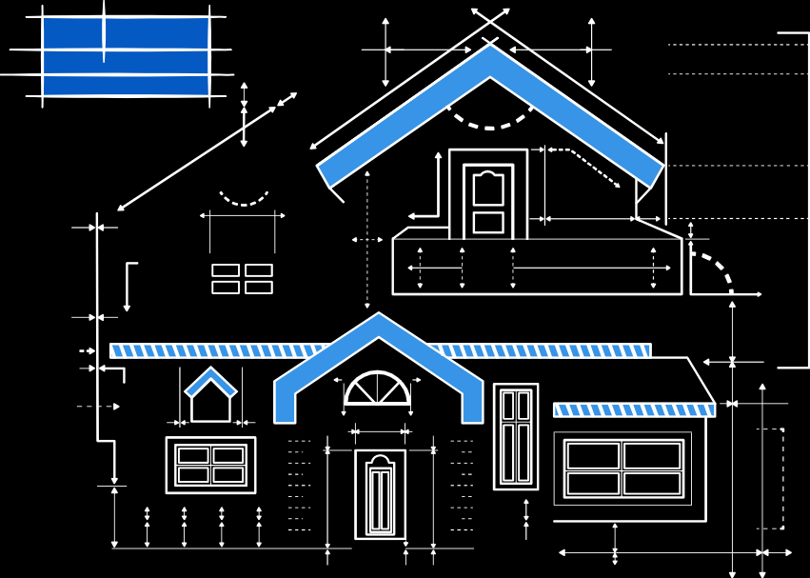
Interfaces vs. Classes
Interface
Class

Slide 5
Creating an Interface
interface Employee {
}

Slide 6
Creating an Interface
interface Employee {
name: string; title: string;
}

Slide 7
Creating an Interface
interface Employee {
name: string; title: string;
}
interface Manager extends Employee { department: string; numOfEmployees: number;
}

Slide 8
Creating an Interface
interface Employee {
name: string; title: string;
}
interface Manager extends Employee { department: string; numOfEmployees: number;
}

Slide 9
Creating an Interface
interface Employee {
name: string; title: string;
}
interface Manager extends Employee { department: string; numOfEmployees: number;
scheduleMeeting: (topic: string) => void;
}

Slide 10
TypeScript’s Structural Type System
interface Employee { name: string; title: string;
}
let developer = { name: 'Michelle',
title: 'Senior TypeScript Developer', editor: 'Visual Studio Code'
}

Slide 11
TypeScript’s Structural Type System
interface Employee { name: string; title: string;
}
let developer = {
name: 'Michelle',
title: 'Senior TypeScript Developer',
editor: 'Visual Studio Code'
}

Slide 12
TypeScript’s Structural Type System
interface Employee { name: string; title: string;
}
let developer = { name: 'Michelle',
title: 'Senior TypeScript Developer',
editor: 'Visual Studio Code'
}

Slide 13

TypeScript’s Structural Type System
interface Employee { name: string; title: string;
}
let developer = { name: 'Michelle',
title: 'Senior TypeScript Developer', editor: 'Visual Studio Code'
}
let newEmployee: Employee = developer;

Slide 14

Demo
Creating interfaces

Slide 15
Method implementations
Property implementations Accessors (getters and setters) Access modifiers
Class Members
Public
Private
Protected

Slide 16
Class Members
class Developer { department: string; private _title: string;
}

Slide 17
Class Members
class Developer { department: string; private _title: string; get title(): string {
return this._title;
}
set title(newTitle: string) { this._title = newTitle.toUpperCase();
}
documentRequirements(requirements: string): void { console.log(requirements);
}

Slide 18
Class Members
class Developer { department: string; private _title: string; get title(): string {
return this._title;
}
set title(newTitle: string) { this._title = newTitle.toUpperCase();
}
documentRequirements(requirements: string): void { console.log(requirements);
}

Slide 19
Class Members
class Developer { department: string; private _title: string; get title(): string {
return this._title;
}
set title(newTitle: string) { this._title = newTitle.toUpperCase();
}
documentRequirements(requirements: string): void { console.log(requirements);
}

Slide 20
Class Members
class Developer { department: string; private _title: string; get title(): string {
return this._title;
}
set title(newTitle: string) { this._title = newTitle.toUpperCase();
}
documentRequirements(requirements: string): void { console.log(requirements);
}

Slide 21
ECMAScript Private Fields
class Developer {
department: string; private title: string;
}

Slide 22
ECMAScript Private Fields
class Developer {
department: string; private title: string;
#salary:
number;
}

Slide 23
ECMAScript Private Fields
class Developer {
department: string; private title: string;
#salary:
number;
}

Slide 24
Extending a Class
class WebDeveloper extends Developer {
}

Slide 25
Extending a Class
class WebDeveloper extends Developer {
favoriteEditor: string; writeTypeScript(): void {
// write awesome code
}
}

Slide 26
Extending a Class
class WebDeveloper extends Developer {
favoriteEditor: string; writeTypeScript(): void {
// write awesome code
}
}
let webdev: WebDeveloper = new WebDeveloper();

Slide 27
Extending a Class
class WebDeveloper extends Developer {
favoriteEditor: string; writeTypeScript(): void {
// write awesome code
}
}
let webdev: WebDeveloper = new WebDeveloper(); webdev.department = 'Software Engineering'; webdev.favoriteEditor = 'Visual Studio Code';

Slide 28
Implementing an Interface
interface Employee { name: string; title: string; logID: () => string;
}

Slide 29
Implementing an Interface
interface Employee { name: string; title: string; logID: () => string;
}
class Engineer implements Employee { name: string;
title: string;
}

Slide 30
Implementing an Interface
interface Employee { name: string; title: string; logID: () => string;
}
class Engineer implements Employee { name: string;
title: string;
}

Slide 31
Implementing an Interface
interface Employee { name: string; title: string; logID: () => string;
}
class Engineer implements Employee { name: string;
title: string; logID() {
return `${this.name}_${this.title}`;
}
}

Slide 32
Demo
Creating classes

Slide 33
Demo
Configuring a project with multiple source files

Slide 34
Static Members
class WebDeveloper extends Developer {
static jobDescription: string = 'Build cool things!'; static logFavoriteProtocol() {
console.log('HTTPS, of course!');
}
}

Slide 35
Static Members
class WebDeveloper extends Developer {
static jobDescription: string = 'Build cool things!'; static logFavoriteProtocol() {
console.log('HTTPS, of course!');
}
}

Slide 36
Static Members
class WebDeveloper extends Developer {
static jobDescription: string = 'Build cool things!'; static logFavoriteProtocol() {
console.log('HTTPS, of course!');
}
logJobDescription(): void { console.log(WebDeveloper.jobDescription);
}
}

Slide 37
Static Members
class WebDeveloper extends Developer {
static jobDescription: string = 'Build cool things!'; static logFavoriteProtocol() {
console.log('HTTPS, of course!');
}
logJobDescription(): void { console.log(WebDeveloper.jobDescription);
}
}

Slide 38
Static Members
class WebDeveloper extends Developer {
static jobDescription: string = 'Build cool things!'; static logFavoriteProtocol() {
console.log('HTTPS, of course!');
}
logJobDescription(): void { console.log(WebDeveloper.jobDescription);
}
}
WebDeveloper.logFavoriteProtocol();

Slide 39
Constructors
class Developer { constructor() {
}
}

Slide 40
Constructors
class Developer { constructor() {
}
}

Slide 41
Constructors
class Developer { constructor() {
console.log('Creating a new developer.');
}
}

Slide 42
Constructors
class Developer { constructor() {
console.log('Creating a new developer.');
}
}
class WebDeveloper extends Developer { readonly favoriteEditor: string; constructor(editor: string) {
super();
this.favoriteEditor = editor;
}
}

Slide 43
Constructors
class Developer { constructor() {
console.log('Creating a new developer.');
}
}
class WebDeveloper extends Developer { readonly favoriteEditor: string; constructor(editor: string) {
super();
this.favoriteEditor = editor;
}
}

Slide 44
Constructors
class Developer { constructor() {
console.log('Creating a new developer.');
}
}
class WebDeveloper extends Developer { readonly favoriteEditor: string; constructor(editor: string) {
super();
this.favoriteEditor = editor;
}
}

Slide 45
Constructors
class Developer { constructor() {
console.log('Creating a new developer.');
}
}
class WebDeveloper extends Developer { readonly favoriteEditor: string; constructor(editor: string) {
super();
this.favoriteEditor = editor;
}
}

Slide 46
Constructors
class Developer { constructor() {
console.log('Creating a new developer.');
}
}
class WebDeveloper extends Developer { readonly favoriteEditor: string; constructor(editor: string) {
super();
this.favoriteEditor = editor;
}
}

Slide 47
Demo
Refactoring the demo app with classes

Slide 48
Summary
Interfaces and Classes
Structural type system Supporting multiple source files Flexibility

Slide 49
Up Next:
Creating and Consuming Modules

